Slide 1
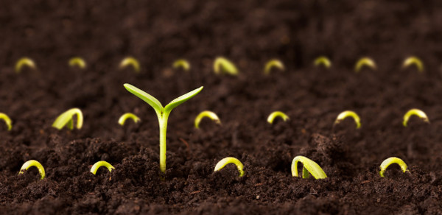
The Effects of Biochar on Plant Growth
David Rice
110110356
Dr Marcel Jansen
Professor Peter Jones
March 2014

Slide 2
What is Biochar?
Carbon rich product
Obtained when biomass (wood, manure, leaves) is thermally decomposed at temperatures between 350-750°C
- Via process known as pyrolysis
Used as a soil enhancer and to try to increase soil fertility
Does not add nutrients to the soil, but may help to retain the nutrients present
Reduces soil pH
Increases soil retention

Slide 3
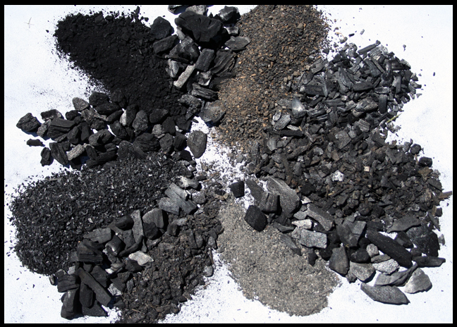
Biochar
Biochars physical and chemical characteristics are dependent on 2 main variables:
Type of pyrolysis undertaken
Slow
Medium
Fast
Type of feedstock used

Slide 4
Pyrolysis
Thermo-chemical decomposition of biomass
Biochar, bio-oil and bio-gas are the main products.
3 types of pyrolysis:
Slow: Most common, hours-days, ~500°C, yields produced bio-oil(30%), biochar(35%), bio-gas(35%)
Medium: Formed in minutes, ~500°C, yields are relatively equal
Fast: formed in seconds, >500°C, bio-oil(75%), bio-gas(13%), biochar(12%)

Slide 5
Aims & Objectives
Aim:
To look at influences of biochar on oat seeds in two separate growth mediums with the addition of the following concentrations of biochar; 0% (control), 0.3%, 1%, 3% and 10%
Objectives:
Determine effects of biochar on oat seed germination
Quantify the effects of various conc. of biochar on the growth of the oat plant
Evaluate results for both mediums and compare them to each other

Slide 6
General Information
Biochar sourced from “Biochar Ireland”, Lough Derg, Co. Donegal
Formed via slow pyrolysis process
Biomass used was local ash timber
Growth mediums used:
John Innes No.2
Horticultural Sand
The seeds used were
common oats

Slide 7
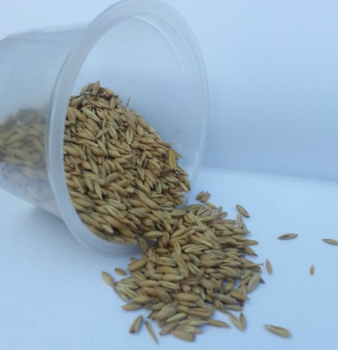
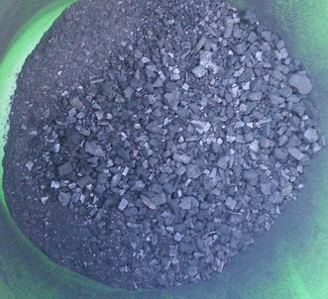
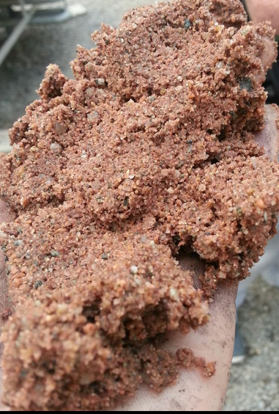
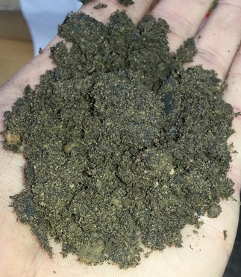
Oat Seeds
Biochar
Sand
John Innes No.2

Slide 8
Project Introduction
22/10/13 – 10/12/13 (8weeks)
Concentrations of biochar used: 0% (control), 0.3%, 1%, 3%, 10%
4 replicates for each concentration
Overall 40 pots (20 for sand + 20 for J.I. No.2)
5 oat seeds placed in each
Germination experiment
Parameters measured: Height, weight, number of leaves, number of pests, Fv/Fm (stress), chlorophyll content.

Slide 9
Germination - Method
All pots were filled with respective growth medium and biochar concentration (w/w)
5 oat seeds were placed in each pot and pushed down 2mm
Pots were placed in greenhouse
Pots were watered every 2 days
The percentage of seeds germinated were recorded on days 3, 5, 7 and 14

Slide 10
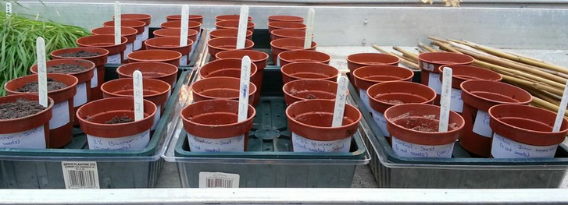
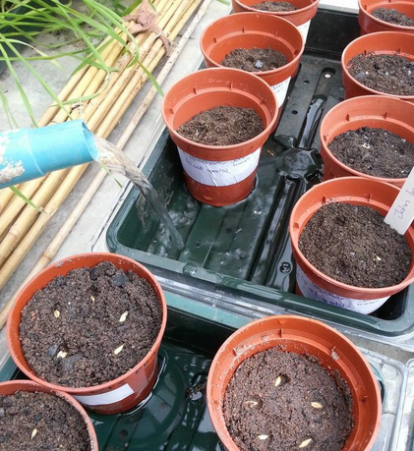
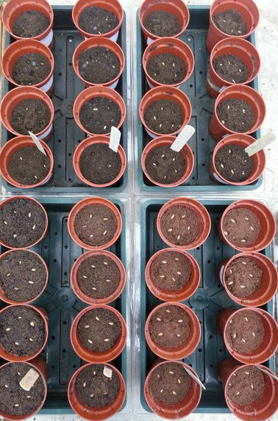
Day 0

Slide 11
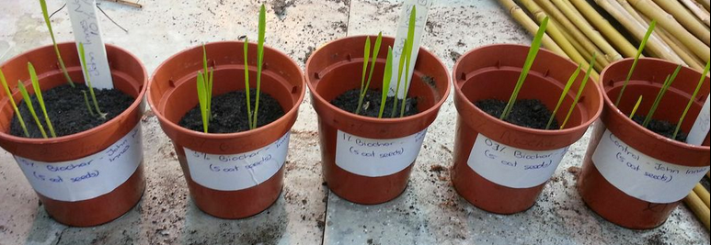
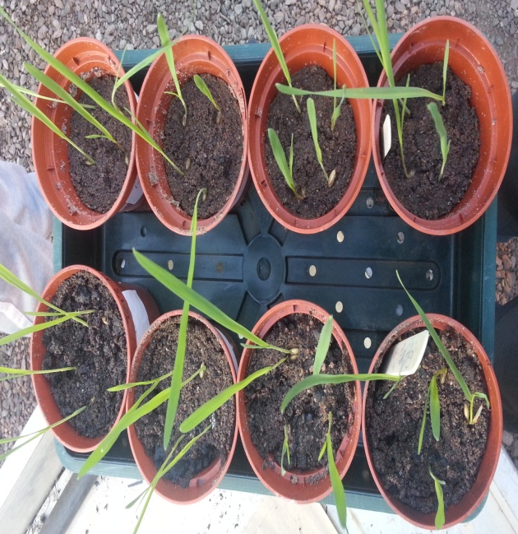
Day 3
Day 5
Day 7
Day 14

Slide 12
Methods
The same plants were used from germination experiment
The weakest plant was taken out (leaving 4)
They were watered and monitored for 8 weeks
After 8 weeks each respective parameter was measured:
Height – Ruler
Weight – Weighing scales
Number of leaves – Counted
Number of pests (Aphids) – Counted
Fv/Fm (stress) - Fluorometer Teaching-PAM (laser)
Chlorophyll content - Chlorophyll Meter SPAD

Slide 13
Fluorometer Teaching-PAM
Chlorophyll Meter SPAD
Aphids on the leaf

Slide 14
Results
The results of the germination experiment show that the oat seeds had a higher % germination in the sand compared to J.I. No.2
At the end of the 8 week investigation all the parameters measured favoured the addition of biochar to the J.I. No.2 medium
All parameters in the J.I. No.2 medium grew significantly better with the addition of biochar when compared to the control
Plants grew taller, heavier, had more leaves, less pests, less stress and were healthier when the biochar was mixed with J.I. No.2 when compared to the sand medium

Slide 16
Plant Height

Slide 17
Plant Weight

Slide 18
Number of Pests Per Plant

Slide 20
Discussion
Biochar benefits John Innes No.2
Fertile medium
Ability to retain nutrients and water (CEC)
Biochar does not benefit growth on sand
No nutrients present
Sand has very low cation exchange capacity
Biochar stimulates germination
Improved % germination for both
mediums
Higher % germination in sand
Ability to retain water

Slide 21
Pests (Aphids)
Reduces the amount of pests per plant
Bio-oil potentially used as insect repellent (fast pyrolysis)
Future in Irelands Agriculture
Brown soils – rich and fertile
A lot of biochar needed
Very expensive
Would cost €500 to cover field of 100x100m (3% biochar)
Future in seed tray/horticulture
Can greatly increase biomass in greenhouse
Not expensive in small amounts
Easy to work with

Slide 22
Conclusion
Based on the studies, experiments undertaken and various literature sources it can be concluded that biochar works well as a soil enhancer, but only in certain circumstances.
It works better in more fertile soils and in countries such as Ireland would work better on a smaller scale (i.e. Horticulture)
The increase in biochar concentration in both mediums increased the % of seeds germinated suggesting it stimulates germination rates.
Finally, biochar also appears to work as some sort of insect repellent but it is early days on this and many more investigation will have to take place in order to get a better sense of reliability.

Slide 23
Reccomendations
I would recommend biochar for the growth of plants in greenhouses or horticulture. In Ireland it would simply not be feasible on a much larger scale. Overall it could greatly improve small scale production in Ireland as it can benefit soil in many ways such as increasing pH, cation exchange, water and nutrient retention.

